Slide 1
The Impact of National Science Foundation (NSF) Funding on Academic Output of Scholars
Scrapers
Team Members:
Guankun Li : guankun@uchicago.edu
Jiazheng Li : jiazheng123@uchicago.edu
Tianyue Cong : tianyuec@uchicago.edu
Weiwu Yan : weiwuyan@uchicago.edu
GitHub: https://github.com/macs30122-winter24/final-project-scrapers.git
MACS 30122

Slide 2
Background
Funding facilitates the acquisition of resources necessary for research. This project examines the pivotal role of the National Science Foundation (NSF) funding in shaping the academic output of scholars within the realms of Behavioral and Cognitive Sciences.
The focus on Behavioral and Cognitive Sciences is deliberate and strategic. This domain stands at the crossroads of natural sciences and social sciences. The inherent diversity within this field, with its clear subdivision into various subfields, provides a unique opportunity to analyze the impact of funding across different areas of study.
MACS 30122

Slide 3
Social Science Significance
In the contemporary landscape of scientific development, research funding has emerged as one of the most crucial public resources. Research funding, by allocating financial resources to research projects, institutions, and researchers, is instrumental in catalyzing innovation, facilitating growth within academic disciplines, advancing the careers of scientists, and contributing to the broader socio-economic development (Lane, 2009). The contribution of research funding to knowledge production is substantial.
For instance, between 2009 and 2010, out of 2,060,838 research papers indexed in the Science Citation Index (SCI), 1,165,276 papers (56.54\%) received at least one form of research funding support (Mahesh, 2012). This underscores the significance of evaluating the outcomes and impact of research funding.
MACS 30122

Slide 4
Research Questions
RQ1
Does NSF funding increase the quantity or quality of academic output of scholars?
RQ2
Which subfields within Behavioral and Cognitive Sciences are more likely to be awarded funding?
RQ3
Which subfields within Behavioral and Cognitive Sciences are more significantly affected by NSF funding?
MACS 30122

Slide 5
National Science Foundation: downloaded award records from 2011 to 2020 from the official website
Data Collection
Google Scholar: scraped academic backgrounds and achievements based on names and emails of award receivers
Academic Journal Sites: dynamically scraped abstracts of papers published within a three-year period both before and after the funding based on Google Scholar pages
MACS 30122

Slide 6
Descriptive Statistics
Table 1:Descriptive Statistics
Variable | Obs | Mean | SD | Min | Median | Max
year | 20640 | 2015.5 | 2.872 | 2011 | 2015 | 2020
award amount | 20640 | 1.30e+05 | 2.70e+05 | 0 | 0 | 3.24e+06
ln(award amount) | 20640 | 5.280 | 5.974 | 0 | 0 | 14.990
award(binary) | 20640 | 0.444 | 0.497 | 0 | 0 | 1
total citations | 20640 | 8797.634 | 17447.221 | 1 | 3902.5 | 3.62e+05
h-index | 20640 | 33.613 | 22.731 | 1 | 29 | 192
citations | 20113 | 476.106 | 965.345 | 1 | 210 | 24631
publications | 20640 | 5.472 | 10.209 | 0 | 4 | 1129
citations of top 3 cited papers | 20004 | 84.654 | 305.650 | 0 | 33 | 22244
MACS 30122

Slide 7
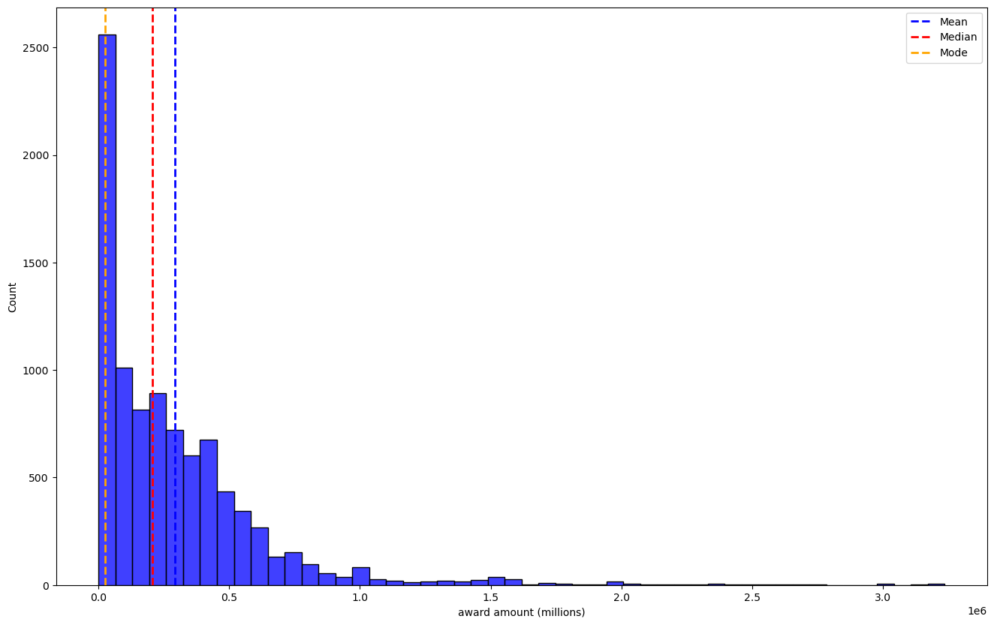
Award Distribution by Amount
Figure 1 displays the distribution of NSF funding award amounts, which is observed to be highly skewed. Therefore, in subsequent regressions, we have log-transformed the award amounts to address this skewness.
Figure 1 Distribution of Award Amount
MACS 30122

Slide 8
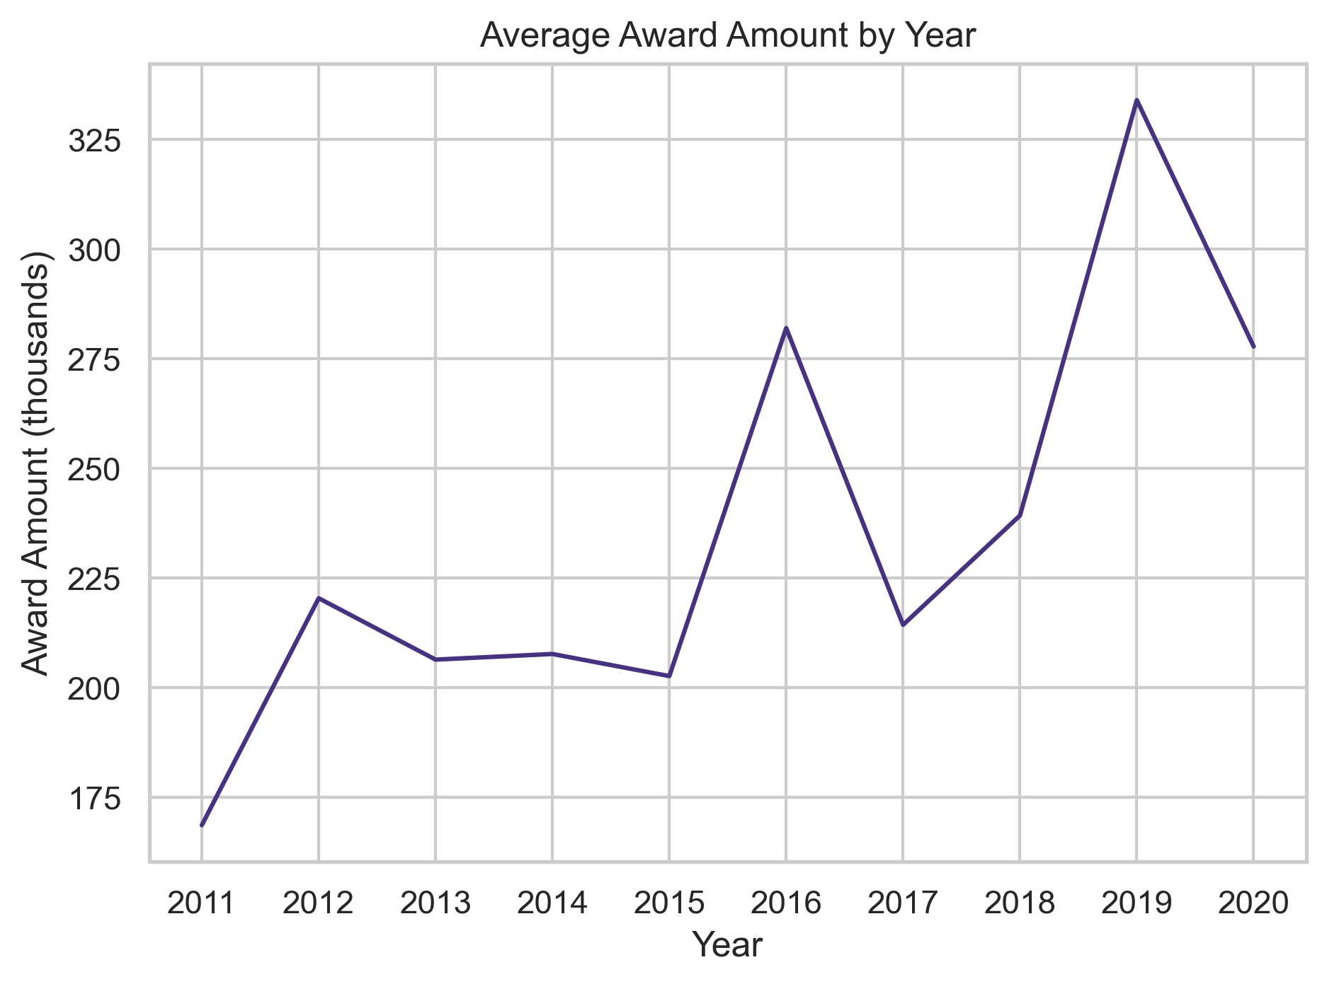
Average Award Amount by Year
Figure 2 presents the trend of cumulative NSF funding award amounts over time. It is evident that there is a clear upward trend in funding as the years progress. This observation justifies our model specification that incorporates controlling for time-fixed effects.
Figure 2 Variation of Award Amount by Year
MACS 30122

Slide 9
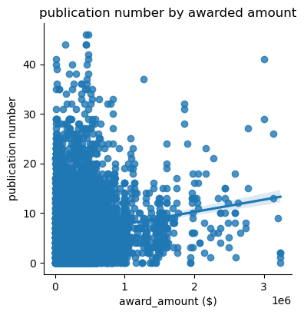
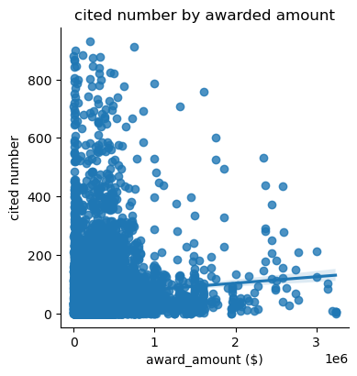
Scatter Plot
Figures 3 and 4 respectively depict scatter plots of NSF funding award amounts against the quantity and quality of publications, indicating a positive correlation. However, whether this relationship changes upon the inclusion of control variables requires further determination through regression analysis.
Figure 3 Scatter Plot (funding and pub quantity)
Figure 4 Scatter Plot (funding and pub quality)
MACS 30122

Slide 10
OLS Linear Regression
Dependent variables
number of publications (quantity)
citations of top three most cited papers (quality)
Independent variables
natural log of award amount
award (binary encoding)
Control variables
h-index & total citations
Fixed effects
year
MACS 30122

Slide 11
OLS Linear Regression (baseline)
Table 2: Baseline Regression
 | (1) | (2) | (3) | (4)
 | quantity | quality | quantity | quality
ln(award amount) | 0.0909*** | -1.689***
 | (0.00997) | (0.413)
h-index | 0.143*** | 0.258 | 0.144*** | 0.252
 | (0.00565) | (1.106) | (0.00564) | (1.106)
total citations | 0.000522*** | 0.104** | 0.000522*** | 0.104**
 | (0.000185) | (0.0405) | (0.000184) | (0.0405)
award(binary) |  |  | 1.086*** | -20.18***
 |  |  | (0.149) | (4.646)
constant | -0.0455 | 36.09* | -0.0590 | 36.33*
 | (0.136) | (20.87) | (0.125) | (20.90)
N | 20113 | 19511 | 20113 | 19511
R² | 0.129 | 0.118 | 0.129 | 0.118
adj. R² | 0.128 | 0.118 | 0.128 | 0.118
Standard errors in parentheses
* p < 0.1, ** p < 0.05, *** p < 0.01
MACS 30122

Slide 12
OLS Linear Regression (panel data)
Table 3: Regression with Time Fixed Effect Controlled
 | (1) | (2) | (3) | (4)
 | quantity | quality | quantity | quality
ln(award amount) | 0.0961*** | -0.0108
 | (0.0126) | (0.377)
h-index | 0.142*** | -0.0970 | 0.142*** | -0.0951
 | (0.00599) | (1.129) | (0.00599) | (1.129)
total citations | 0.000558*** | 0.114*** | 0.000555*** | 0.114***
 | (0.000187) | (0.0410) | (0.000187) | (0.0410)
award(binary) |  |  | 1.135*** | -1.280
 |  |  | (0.183) | (4.143)
year | controlled | controlled | controlled | controlled
constant | -0.113 | 83.94*** | -0.134 | 84.00***
 | (0.183) | (27.70) | (0.181) | (27.70)
N | 20113 | 19511 | 20113 | 19511
R² | 0.130 | 0.132 | 0.129 | 0.132
adj. R² | 0.129 | 0.131 | 0.129 | 0.131
Standard errors in parentheses
* p < 0.1, ** p < 0.05, *** p < 0.01
MACS 30122

Slide 13
Explanation and Answer to RQ 1
Table 2 presents the results of the baseline regression, revealing that funding award amounts have a significant positive impact on the quantity of scientific output but exhibit a significant negative influence on the quality of scientific output.
Table 3 displays the results of the regression after controlling for time-fixed effects, specifically in models (1) and (2) from Section 1. It is observed that funding award amounts have a significant positive impact on the quantity of scientific output, yet they do not have a significant effect on the quality of scientific output.
Thus, we are able to address Research Question 1: NSF funding significantly enhances the quantity of academic research output in the Behavioral and Cognitive Sciences. However, NSF funding does not have a significant impact on the quality of academic research output in the Behavioral and Cognitive Sciences.
MACS 30122

Slide 14
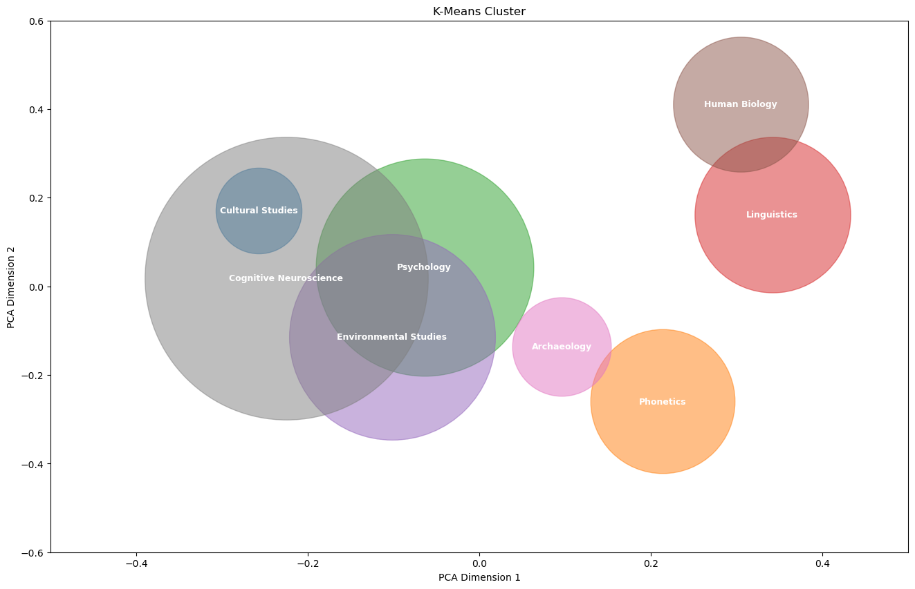
K-means Clustering with TF-IDF
We employed cluster analysis to divide the field of Behavioral and Cognitive Sciences into eight subfields, as detailed in Figure 5. We have identified eight subfields within the Behavioral and Cognitive Sciences: Environmental Studies, Psychology, Cognitive Neuroscience, Phonetics, Human Biology, Linguistics, Cultural Studies, and Archaeology.
Figure 3 Cluster Result
MACS 30122

Slide 15
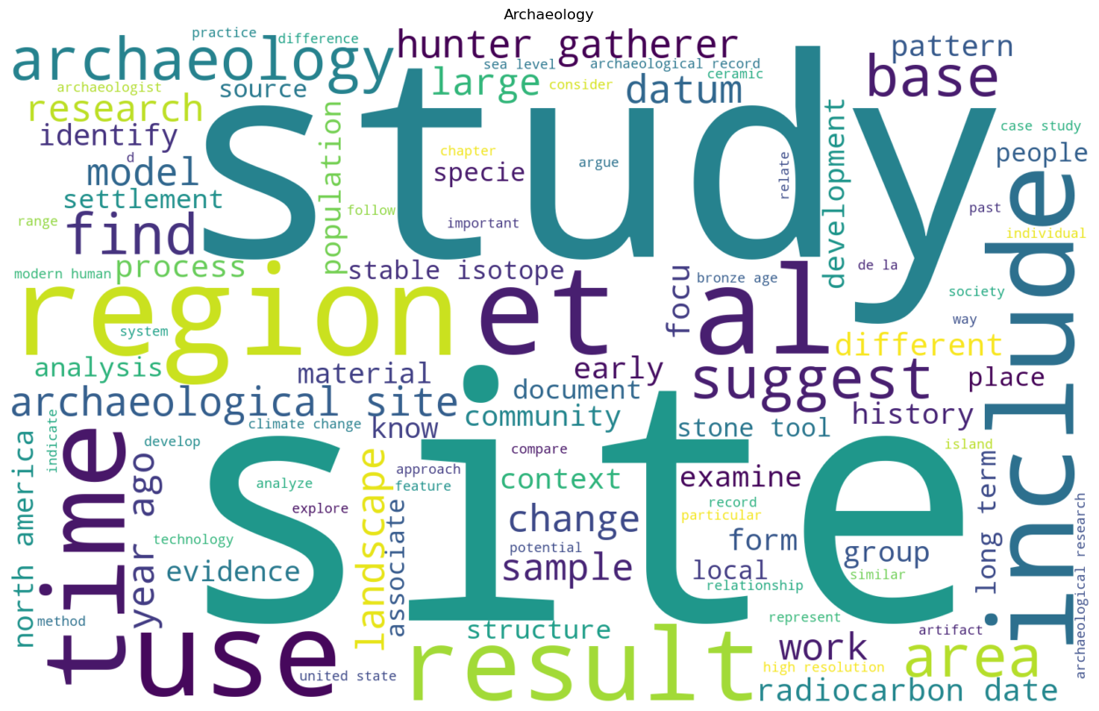
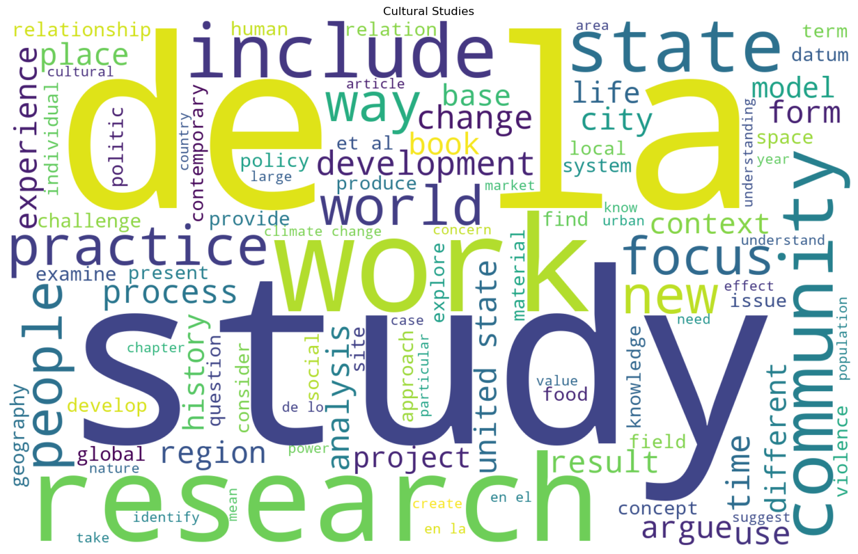
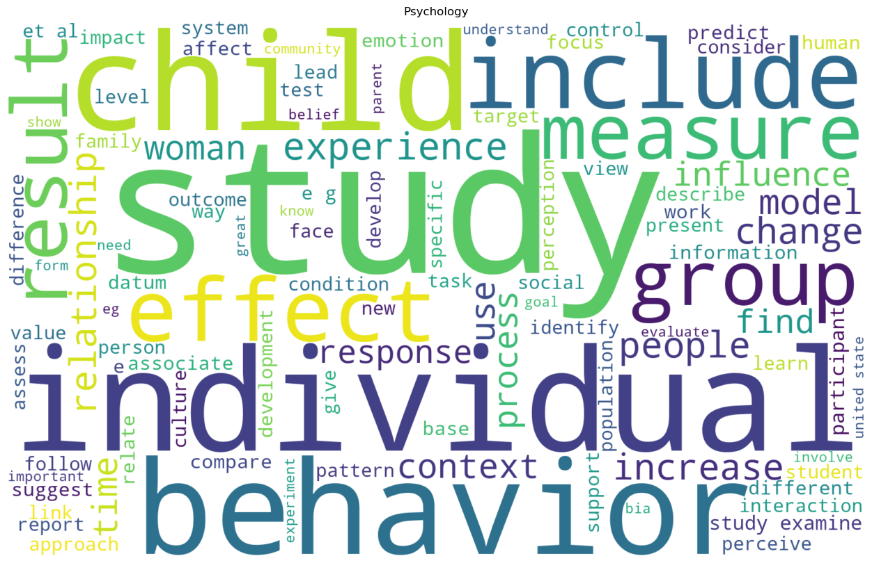
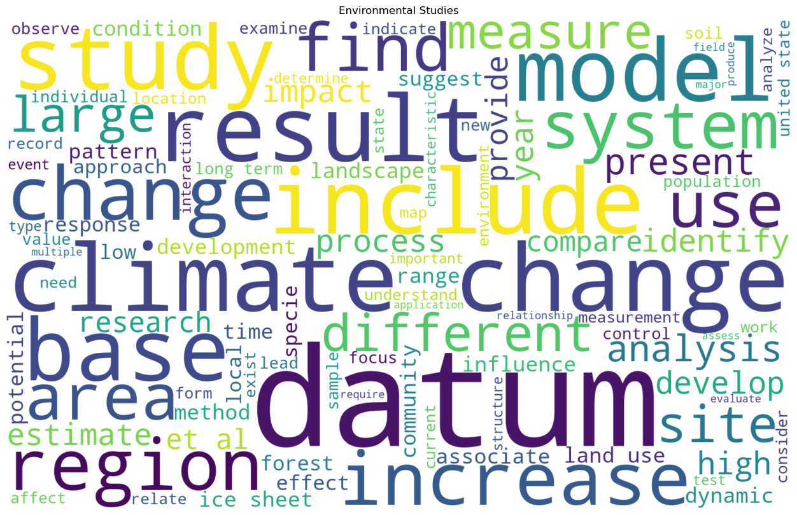
Word Clouds by Cluster
MACS 30122

Slide 16
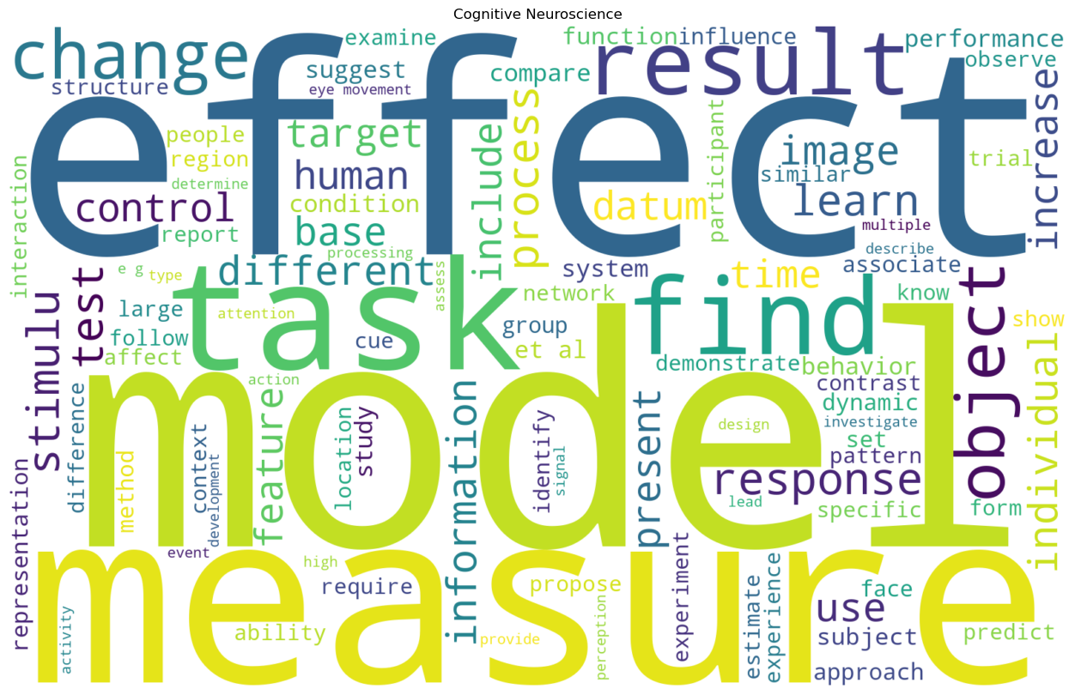
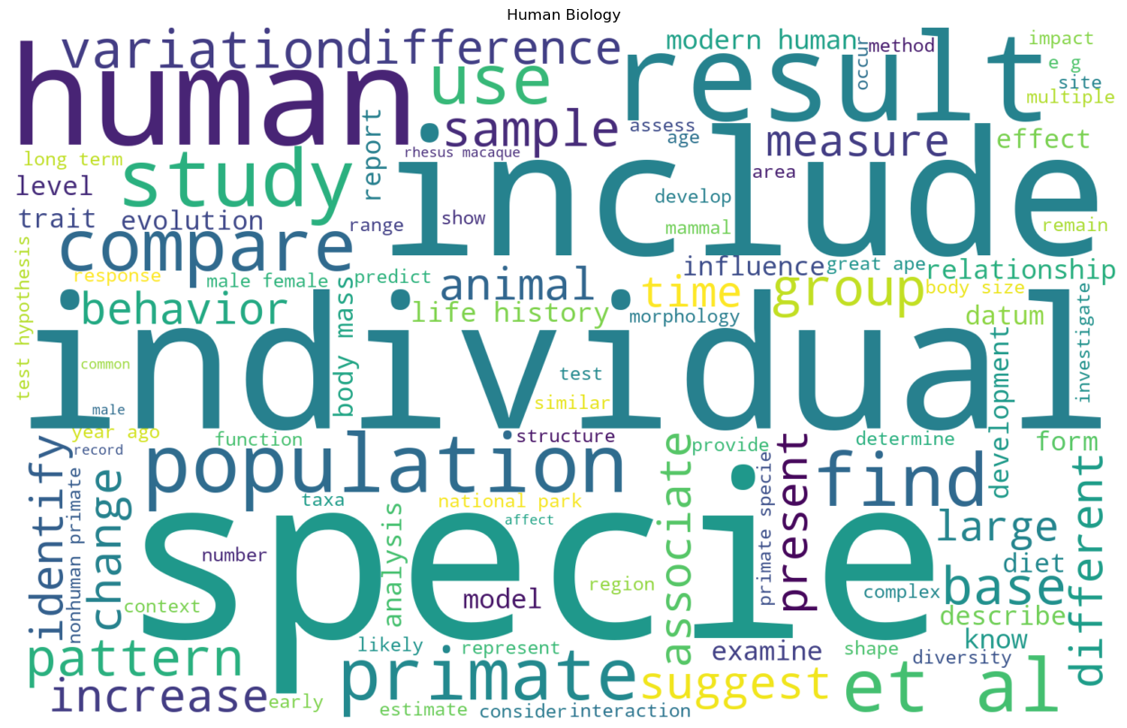
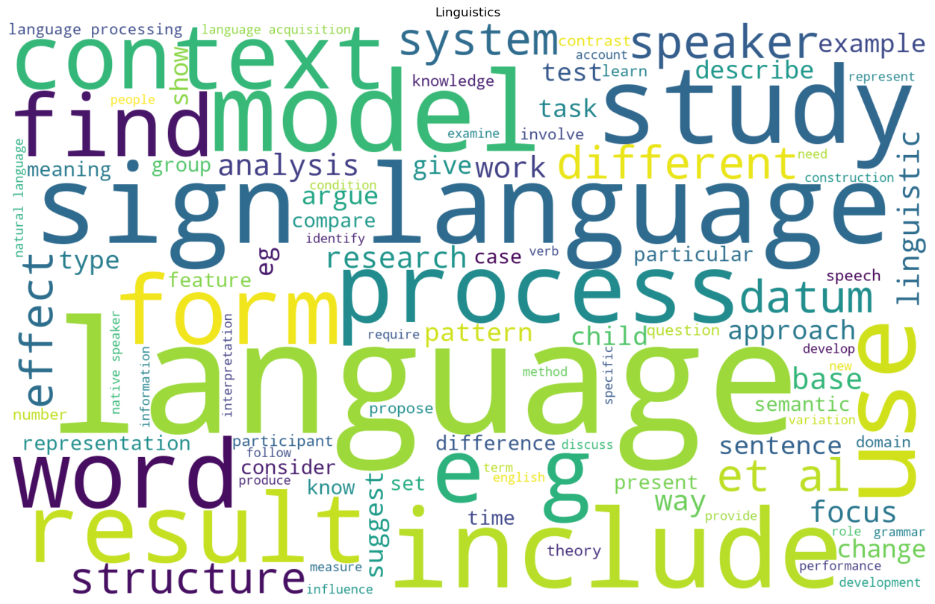
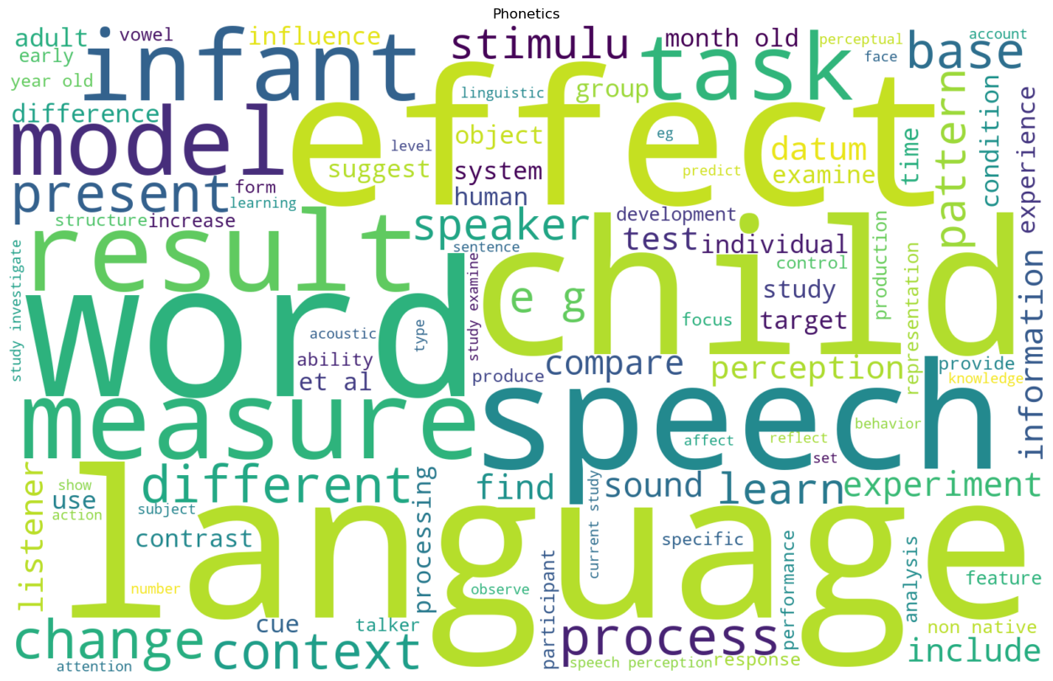
Word Clouds by Cluster
MACS 30122

Slide 17
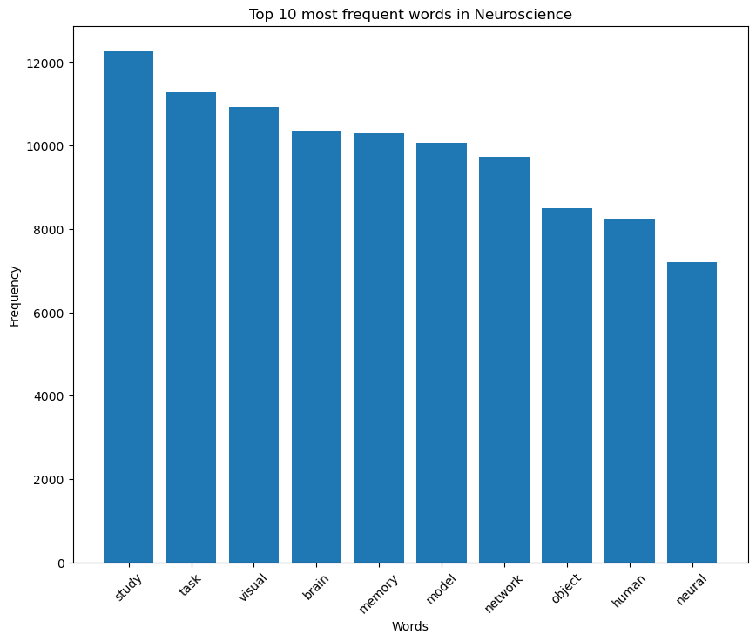
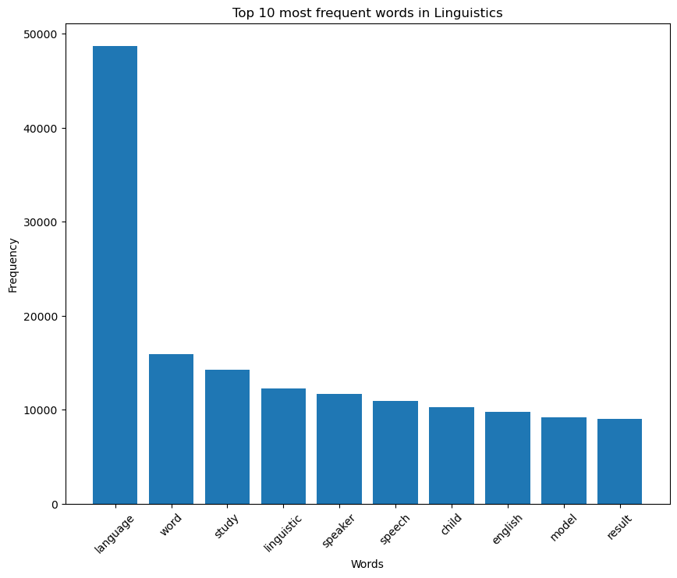
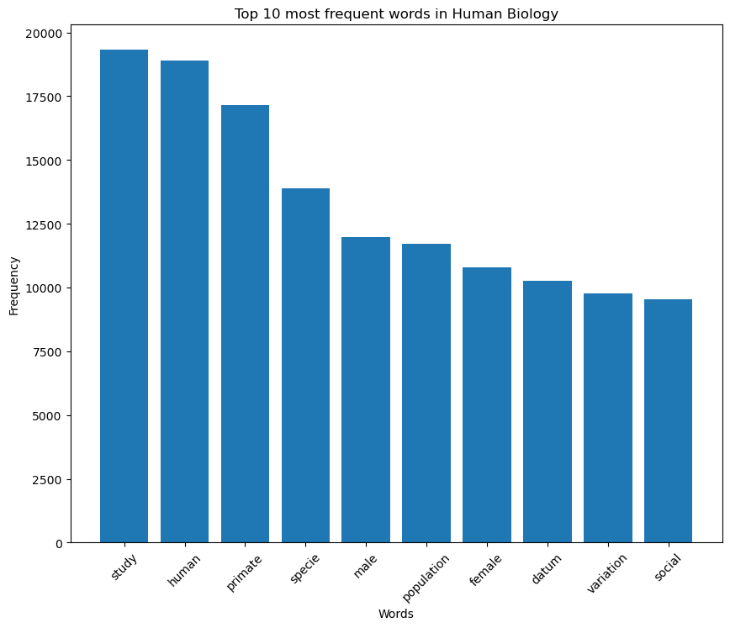
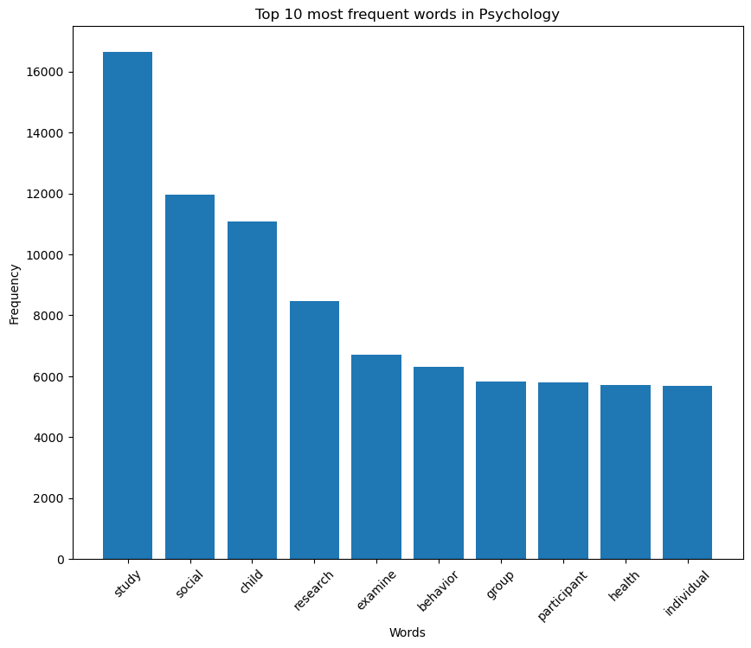
Word Bar Graphs
MACS 30122

Slide 18
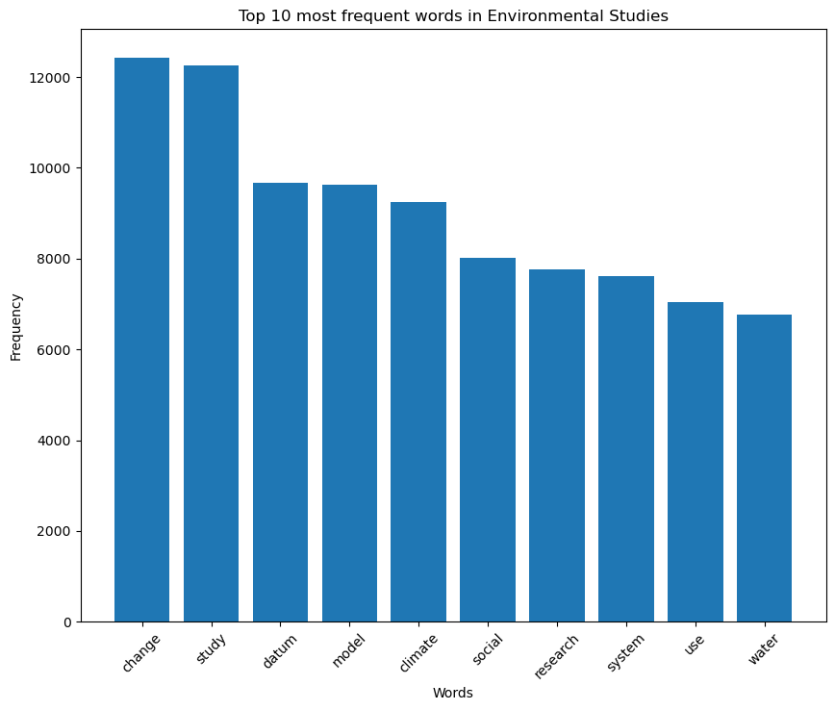
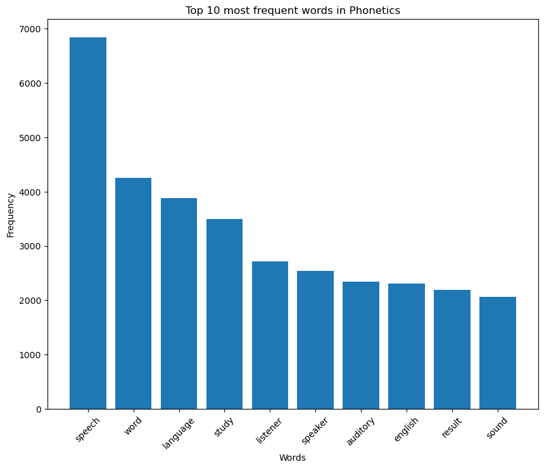
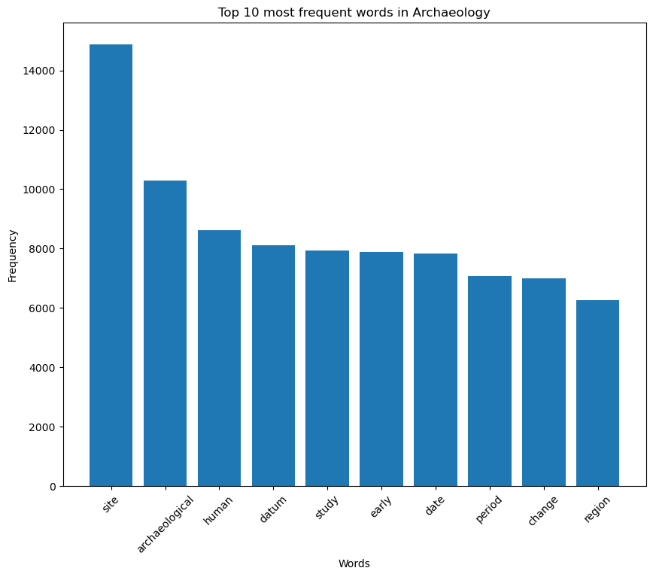
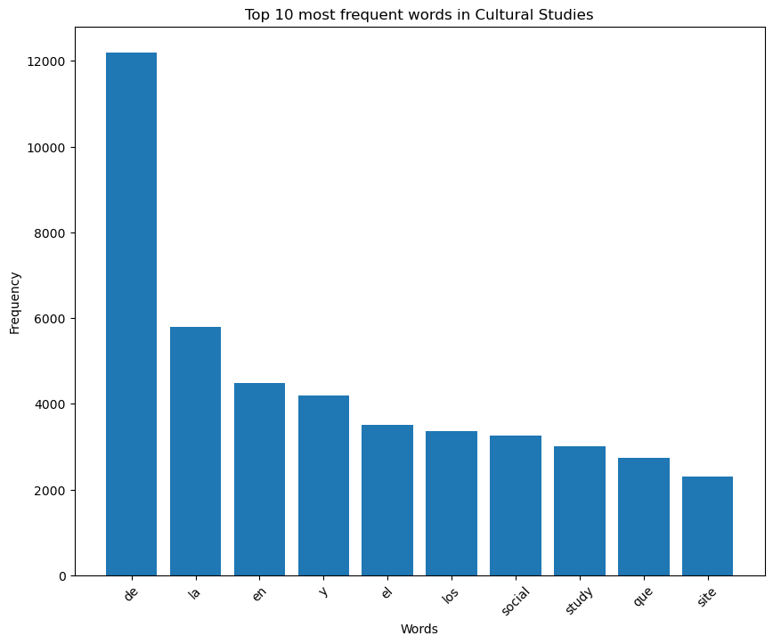
Word Bar Graphs
MACS 30122

Slide 19
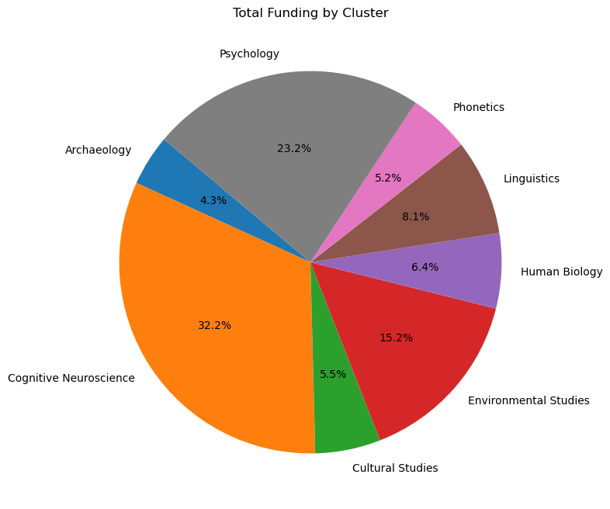
Answer to RQ2
Next, based on the results of our clustering, we can calculate the Average Award Amounts by Cluster for each subfield, and then make comparisons. This allows us to answer RQ 2: Even within the same research division of Behavioral and Cognitive Sciences, there are clear disparities in the funding received by different subfields. Cognitive Neuroscience obtains the most funding, followed by Psychology and Environmental Studies with moderate amounts, and Human Biology, Archaeology, Phonetics, and Cultural Studies receive the least.
Figure 7 Percentage of Different Subfields
MACS 30122

Slide 20
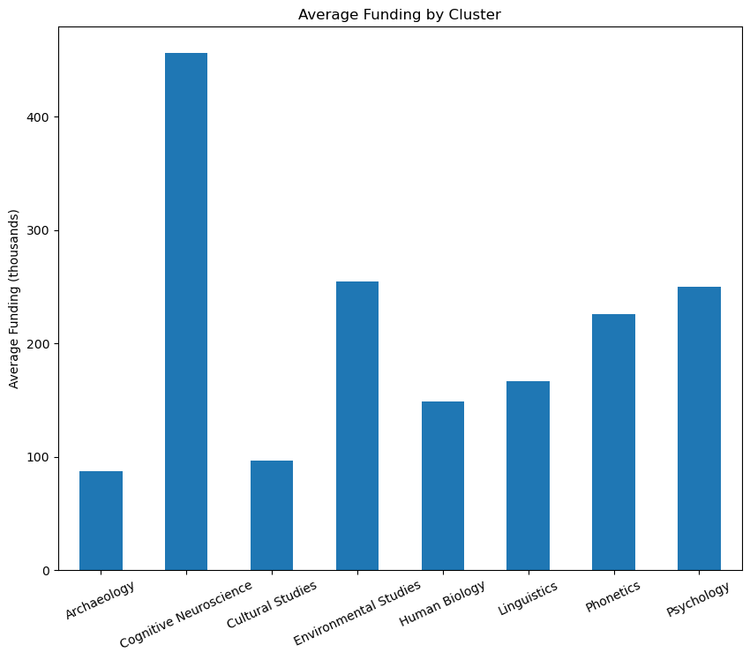
Answer to RQ2
Figure 8 Average Funding of Different Subfields
MACS 30122

Slide 21
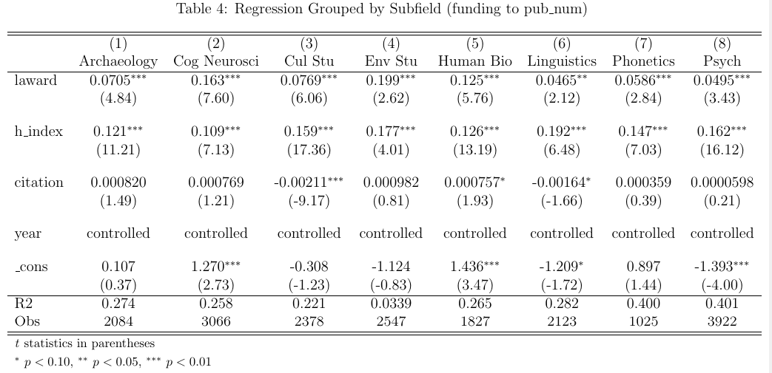
Regression Grouped by Subfield (RQ 3)
Based on the results of the clustering, we conducted grouped regressions for each subfield. Table 4 presents the grouped results. It can be observed that the funding has a significant positive impact on the number of publications across all groups. The coefficients and significant levels for Cognitive Neuroscience, Human Biology, and Environmental Studies are the largest, indicating that funding has a stronger effect within these three subfields.
MACS 30122

Slide 22
Response to Comments
Q1 Is that a "real" effect or a measurement effect in RQ1?
A1 This is a measurement effect since this is not a structural model.
Q2 the reason of getting funding might be because of the previous performance
A2 We control sholars’ ability(h-index) to address this problem.
Q3 whether you accounted for the size of the academic discipline when considering awards?
A3 Yes. In Table 5 and 6 in appendix, we control the discipline fixed effect.
Q4 You chose citations of top three most cited papers to represent the quality, would the result change, if we choose another number, like 5?
A4 No. The result is fairly robust.
Q5 How do you measure quality? If it is measured by the number of references, it might be subject to a large time lag/bias - work that got published earlier has a higher chance of getting more references.
A5 We used the citations of the top three most cited papers, taking into account the large time lag/bias. This is why we control for time-fixed effects. As long as we ensure that the quality data for Author A in year X is all sourced from year X, along with the inclusion of time-fixed effects, we can ensure they are comparable.
MACS 30122

Slide 23
Conclusion
NSF funding significantly enhances the quantity of academic research output in the Behavioral and Cognitive Sciences. However, NSF funding does not have a significant impact on the quality of academic research output in the Behavioral and Cognitive Sciences.
Even within the same research division of Behavioral and Cognitive Sciences, there are clear disparities in the funding received by different subfields. Linguistics obtains the most funding, followed by Psychology, Cognitive Neuroscience, Phonetics, and Cultural Studies with moderate amounts, and Human Biology, Archaeology, and Environmental Studies receive the least.
NSF funding has a stronger effect within Cognitive Neuroscience, Human Biology, and Environmental Studies than that within Archaeology, Psychology, Linguistics, Phonetics, and Cultural Studies
MACS 30122

Slide 24
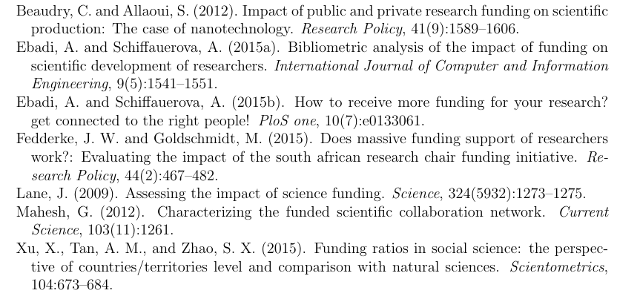
References
MACS 30122

Slide 25
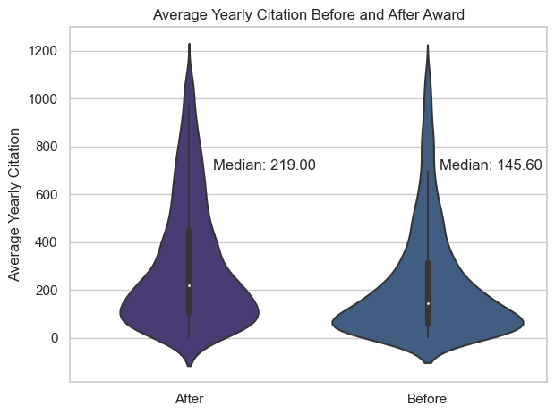
Appendix
Figure 9 Comparison of Average Yearly Citation
MACS 30122
Notes:
In addition to the aforementioned research question, we have conducted several data analyses that are not directly related to the main research question, all of which are included in the appendix.

Slide 26
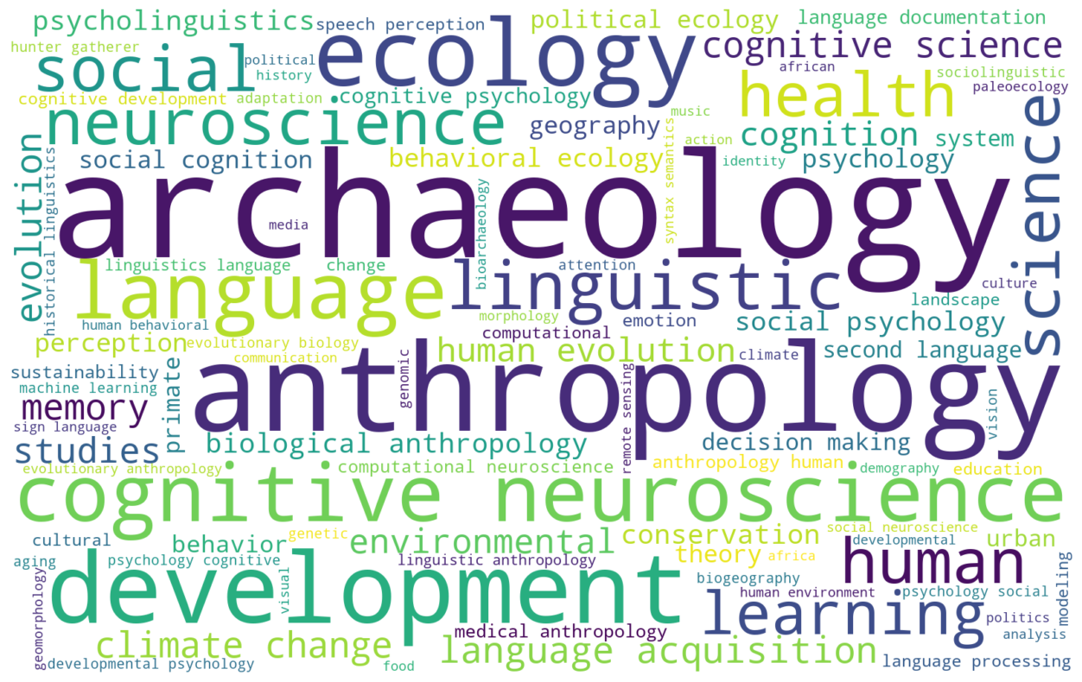
Appendix
Figure 10 Research Interests Word Cloud
MACS 30122

Slide 27
Appendix
Table 5: Panel with K-means Clustering Subfields
 | (1) | (2) | (3) | (4)
 | quantity | quality | quantity | quality
ln(award) | 0.102*** | 0.176
 | (0.0135) | (0.379)
h-index | 0.146*** | 1.388*** | 0.146*** | 1.390***
 | (0.00733) | (0.459) | (0.00737) | (0.458)
total citations | 0.000170 | 0.0576*** | 0.000172 | 0.0576***
 | (0.000222) | (0.0191) | (0.000223) | (0.0191)
award(binary) |  |  | 1.206*** | 0.755
 |  |  | (0.196) | (4.084)
year | controlled | controlled | controlled | controlled
subfield_1 | controlled | controlled | controlled | controlled
constant | -0.451** | 39.85*** | -0.483** | 39.90***
 | (0.194) | (11.42) | (0.192) | (11.38)
N | 18972 | 18405 | 18972 | 18405
R² | 0.118 | 0.088 | 0.118 | 0.088
adj. R² | 0.117 | 0.087 | 0.117 | 0.087
Standard errors in parentheses
* p < 0.1, ** p < 0.05, *** p < 0.01
MACS 30122

Slide 28
Appendix
Table 6: Panel with K-means Clustering Subfields
 | (1) | (2) | (3) | (4)
 | quantity | quality | quantity | quality
ln(award amount) | 0.104*** | 0.112
 | (0.0131) | (0.381)
h-index | 0.153*** | 1.337*** | 0.153*** | 1.339***
 | (0.00625) | (0.495) | (0.00627) | (0.493)
total citations | 0.0000459 | 0.0581*** | 0.0000439 | 0.0581***
 | (0.000218) | (0.0196) | (0.000218) | (0.0196)
award(binary) |  |  | 1.212*** | 0.404
 |  |  | (0.187) | (4.155)
year | controlled | controlled | controlled | controlled
subfield_2 | controlled | controlled | controlled | controlled
constant | 0.0777 | 36.48*** | 0.0416 | 36.49***
 | (0.423) | (12.54) | (0.417) | (12.48)
N | 18972 | 18405 | 18972 | 18405
R² | 0.117 | 0.087 | 0.117 | 0.087
adj. R² | 0.117 | 0.087 | 0.116 | 0.087
Standard errors in parentheses
* p < 0.1, ** p < 0.05, *** p < 0.01
MACS 30122

